Slide 1
NATIONAL UNIVERSITY OF PUBLIC SERVICE
FACULTY OF INTERNATIONAL AND EUROPEAN STUDIES
The EU Legal System and the Case Law of the Court of Justice of the EU
Dr. Miklós Szirbik, LL.M.
10.02.2020
INTRODUCTION

Slide 2
Miklós Szirbik, The EU Legal System and the Case Law of the Court of Justice of the EU
AGENDA
Introduction of teacher
Course Overview and Introduction
Assessment
Literature

Slide 3
Miklós Szirbik, The EU Legal System and the Case Law of the Court of Justice of the EU
Introduction of teacher
2005 State Examination in Law, Goethe University Frankfurt am Main, Germany
2007-2011 LL.M. and Ph.D. Andrássy Gyula German Language University Budapest (EU Law, EU Integration)
2012-2016 State Aid Monitoring Office (TVI), Prime Minister's Office
Other EU Law related tasks: German International Cooperation (GIZ) - Bangladesh Office, Dhaka; FPS Law Firm Frankfurt am Main; CHSH Dezső Law Firm Budapest

Slide 4
Miklós Szirbik, The EU Legal System and the Case Law of the Court of Justice of the EU
Course Overview and Introduction
Additionally to the 4 freedoms within the internal markets (free movement of goods, freedom of establishment and providing services, freedom of free movement of capital and workforce) the following contents on the next slide.

Slide 5
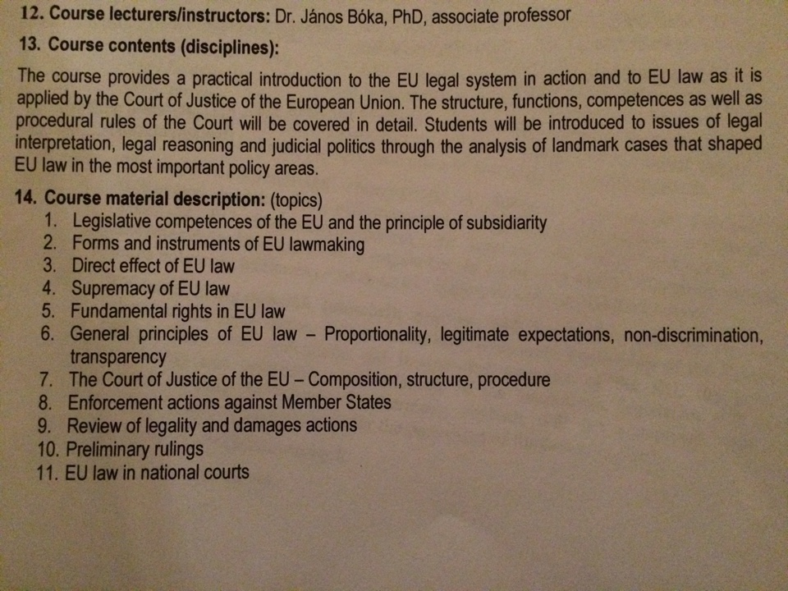
Miklós Szirbik, Public Law of the European Union

Slide 6
Miklós Szirbik, The EU Legal System and the Case Law of the Court of Justice of the EU
Assessment
In-class test within the semester.
Written in-class closed book test.

Slide 7
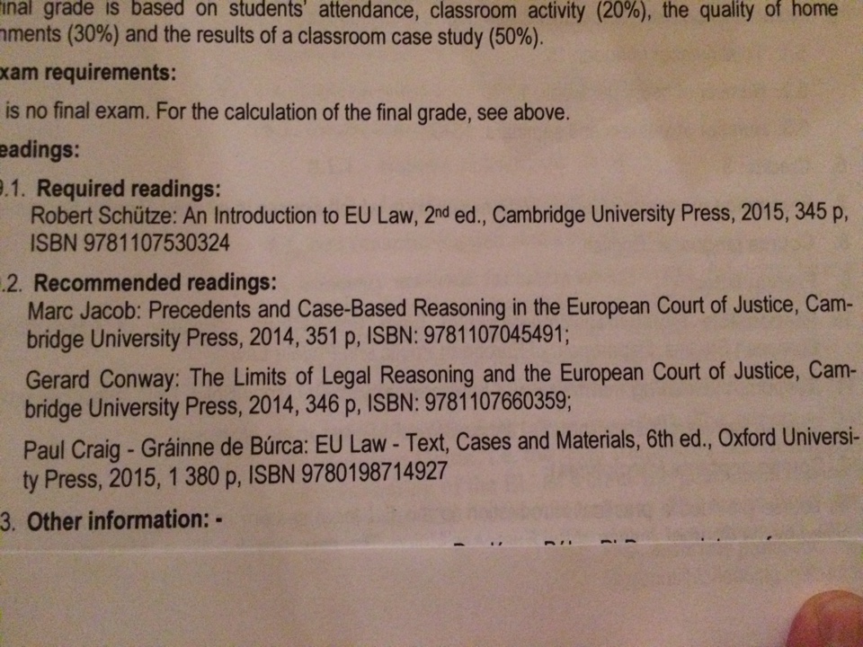
Literature

Slide 8
Miklós Szirbik, The EU Legal System and the Case Law of the Court of Justice of the EU
Literature and additional sources in English
EU in general:
https://europa.eu/european-union/about-eu_en
Case law of EU Court in English, Hungarian and all other EU languages
https://eur-lex.europa.eu/collection/eu-law/eu-case-law.html

Slide 9
Miklós Szirbik, The EU Legal System and the Case Law of the Court of Justice of the EU
Introductional Questions:
What do you think, which economy is larger: that of the U.S.A., the EU or China and how would you measure it?
In your opinion is the EU rather a state or an international organization? What pros and cons can you think of for each direction?

Slide 10
Miklós Szirbik, The EU Legal System and the Case Law of the Court of Justice of the EU
Introductional Questions:
- What do you think, when and why did modern European Integration start?

Slide 11
Thank you for your attention!

